Slide 2

María Hernández Rubio
@maria_hr
Mathematics & Computer Science, UAM
MsC Computational Intelligence, UAM
Senior Data Scientist at BBVA Data & Analytics
Joined BBVA in 2011, Smart Cities, external consultant
Joined Beeva in 2013
Joined BBVA D&A in 2014
Urban Analysis, C360, RecSys
(Non-) Customer Intelligence
Smart Replies

Slide 3
Agenda
Lecture 1: Regularization.
Lecture 2: Bayesian Statistics
Probability Review
Bayes’ Rule
Probabilistic Reasoning
Prior, Posterior, Likelihood
Naïve Bayes.

Slide 4
Probability Review
Bayes’ formula. Independence. Distributions

Slide 5
Definitions and notation
Discrete variables
Let X be a discrete random variable.
P(X = x) is the probability that variable X takes value x in Dom(X)
If there is no confusion, we can simply use P(x). Ej: P(heads)
p(x) represents the distribution (or probability mass function) of variable X over all possible values of x, i.e., p(x) := x → P(X=x).
Ej: p(x) = 0.5, x = tails, heads.

Slide 6
Definitions and notation
Continuous variables
Let X be a continuous random variable,
It does not make sense to say P(X = x), since the probability of a single value is always zero. Only makes sense in intervals.
X has a probability density function f(x), such that
We will often write p(x) for both p(x) in the discrete case and f(x) in the continuous case.

Slide 7
Definitions and notation
Joint Distribution
Let X, Y be discrete random variables, the joint distribution over X and Y is P(X=x, Y=y).
It represents the probability that X takes value x and Y takes value y at the same time.
Similarly to the single-variable case (p(x)), we will use p(x, y) for the joint distribution of X and Y, both for the discrete and continuous case.

Slide 8
Definitions and notation
Marginalization
Given a joint distribution p(x, y), we can marginalize on one variable, i.e., get back the distribution over a single variable, as
Discrete variables
Continuous variables
 | Bald | Not Bald
Male | 0.13 | 0.32
Female | 0.01 | 0.54
Example: X=Gender, Y=Baldness
P(g)?
P(g) = p(g, bald) + p(g, not bald)
p(male) = p(male, bald) + p(male, not bald) = 0.13+ 0.32 = 0.45
p(female) = p(fem., bald) + p(fem., not bald) = 0.01+0.54 = 0.55
More generally,
Notes:
Fórmula de la Probabilidad Total

Slide 9
Definitions and notation
Conditional Probability
The probability of event x conditioning on knowing event y, i.e., the conditional probability of x given y is given by:
Example: P(Male | Bald)
 | Bald | Not Bald
Male | 0.13 | 0.32
Female | 0.01 | 0.54
P(Male | Bald) = P(Male, Bald) / P(Bald)
P(Bald) =(marginalization) = P(Male, Bald) + P(Female, Bald) = 0.01 + 0.13
P(Male | Bald) = 0.13 / 0.14 = 0.93
[Recall P(Male) = 0.45] → Knowing it’s bald, we increase our confident on being a male.

Slide 10
Conditional Probability
Bayes’ Rule
Equivalently,
and p(x, y) = p(y, x), so
Bayes’ Rule
Bayes Rule helps us to invert probability relationships between x and y.

Slide 11
Definitions and notation
Independence
X and Y are independent if p(x, y) = p(x)p(y).
X, Y independent ➔ p(x | y) = p(x)
Exercise: prove above identity.
X, Y independent means that having information on Y does not give extra information on X (and viceversa).
Independence is a very desiderable property when doing bayesian computations, since it allows us to factorize join distributions.

Slide 12
Definitions and notation
Independence
X and Y are independent if p(x, y) = p(x)p(y).
Exercise: are Gender and Baldness independent?
 | Bald | Not Bald
Male | 0.13 | 0.32
Female | 0.01 | 0.54
Solution: NO
We have to check if p(Gender, Baldness) = p(Gender) p(Baldness)
P(Gender): P(Male) = 0.45, P(Female) = 0.55
P(Baldness): P(Bald) = 0.14, P(Not Bald) = 0.86
P(Male, Bald) = 0.13 =? P(Male)*P(Bald) = 0.45*0.14 = 0.063 not independent!
Indeed, we had already prove it since
P(Male|Bald) = 0.93 != P(Male) = 0.45

Slide 13
Probabilistic reasoning
Priori, posterior, likelihood

Slide 14
Probabilistic Reasoning
When learning, we have a set of variables x₁,…, x_{N} and we want to find relations among them, i.e., estimate p(x₁, …, x_{N}).
Bayes + probabilistic rules (ex. Marginalization) form a complete reasoning system so we can use them to infer and estimate the parameters of the model from the available data.

Slide 15
Probabilistic Reasoning
Example (from Barber’s book).
People with disease D almost always ate hamburgers, p(H|D) = 0.9. Probability of having disease D is very low p(D) = 1/100.000
Assume eating hamburgers is rather widespread, p(H)=0.5, what is the probability that a hamburger eater will have disease D?
If the fraction of hamburgers eaters is much smaller, p(H)=0.001, what is now the previous probability?

Slide 16
Probabilistic Reasoning
Example (from Barber’s book).
p(H|D) = 0.9. p(D) = 1/100.000
p(H)=0.5, p(D|H)?
p(D|H) = p(H|D)p(D)/p(H) = 0.9*0.00001/0.5 = 1.8·10⁻⁵
p(H)=0.001, p(D|H)?
P(D|H) = 0.9*0.00001/0.001 = 0.009
If the prevalence of eating H is not that common, knowing that the person ate hamburgers, increases our belief on having the disease.

Slide 17
Bayesian Statistics
Priori, posterior, likelihood

Slide 18
Bayesian Statistics
Consider we have an unknown parameter θthat want to estimate from our data D, i.e., compute what is the most likely value of θgiven data D, p(θ|D). We can use Bayes Rule:
Likelihood:
Assuming θ, how likely is to have data D
Prior:
What is our belief,
before seeing the data
Posterior:
How our belief is updated,
when we observe data D
Evidence
Normalization constant.

Slide 19
Bayesian Statistics
Coin tosses. We toss a coin N times and annotate if it comes up heads (v^{n} = 1) or tails (v^{n} = 0) as {0, 0, 0, 1, 0}. We want to estimate θ=p(v^{n}=1) by ML.
ML is counting!
What if
N_{H}=100 N_{T}=400?

Slide 20
Naïve Bayes
Independence on the features

Slide 21
Naïve Bayes Classifier
Given data point x, we want to assign it to the correspondent class c, i.e., estimating p(c|x) and selecting the maximum
(Conditional probability definition
+ marginalization)
Naïve Bayes model assumes that, if the class c is known, the features x_{i} of x = (x₁, …, x_{d}) are independent, i.e.

Slide 22
Naïve Bayes Classifier
We want to compute the c for which p(c|x) is maximum.
Note that Z does not depend on c, only on the input data point x.
So, Z is a normalization constant and can be ommited in the comparison.

Slide 23
Naïve Bayes Classifier
How do we estimate p(c) and p(x_{i}|c)?
Maximum Likelihood (MLE)
Bayesian estimation (beyond the scope)
Note:
We can do Naïve Bayes without using bayesian statistics!!

Slide 24
Naïve Bayes
Example
Coin tosses. We toss a coin N times and annotate if it comes up heads (v^{n} = 1) or tails (v^{n} = 0) as {0, 0, 0, 1, 0}. We want to estimate θ=p(v^{n}=1) by Naïve Bayes.
Prior: P(1) = 0.6 // P(0) = 0.4
Likelihood: P(0)=0.8, P(1)0.2
Posterior:
P(1) ~ 0.6 * 0.2 = 0.12 -> 0.12/(0.12+0.32) = 0.27
P(0) ~ 0.4 * 0.8 = 0.32 -> 0.32/(0.12+0.32) = 0.73

Slide 25
Naïve Bayes
Maximum Likelihood
Estimate p(c_{k}) and p(x_{i}|c_{k}) through maximum likelihood.
Example: Assume c is a multinomial distribution with parameters
θ={θ_{1,…,}θ_{k}}. x_{i} is binary with values {0,1}.
Note that as we only need K-1 parameters θ.
ML is counting =>
Θ_{k} = p(c_{k}) = count(c_{k})/N , N=number of data points
p(x_{i}|c_{k}) = #positive features x_{i} in class c_{k}

Slide 26
Naïve Bayes
R exercise

Slide 27
Final remarks
Bayesian vs Frequentist.
Continuous prior. Conjugate priors.

Slide 28
MAP vs MLE
Coin tosses. We toss a coin N times and annotate if it comes up heads (v^{n} = 1) or tails (v^{n} = 0) as {0, 0, 0, 1, 0}. We want to estimate θ=p(v^{n}=1) by ML.
MLE=counting: θ=0.25
MAP=counting + considering prior.
MLE = MAP with uniform prior.

Slide 29
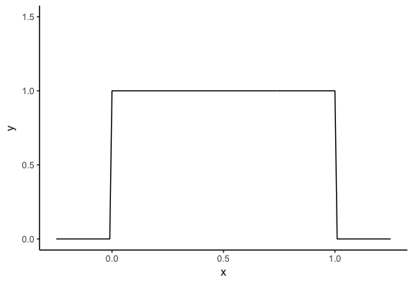
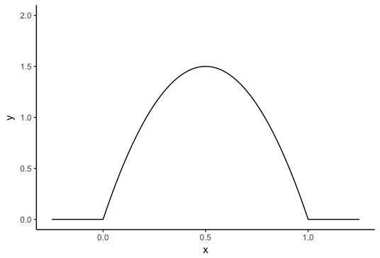
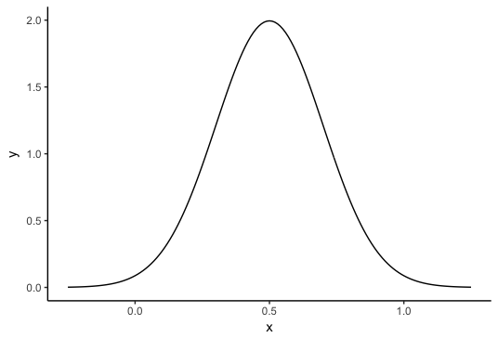
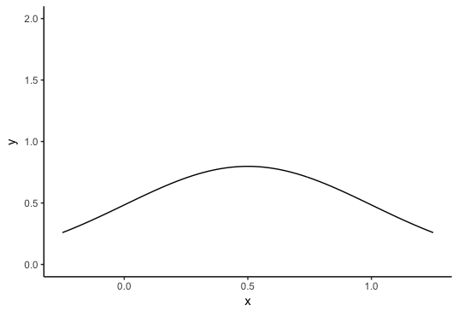
Final remarks
Bonus: continuous priors
Bayesian Estimation is more powerful when considering continuous prior. They show a complete distribution over the parameter set.
For the coin example, what can be a suitable continuous prior?

Slide 30
Final remarks
Prior = Beta distribution
Beta distribution has some useful properties for Bayesian Estimation:
It has a suitable shape
It is conjugate of Binomial distribution, it means that when we multiply beta*binomial we get another beta.
So by observing data (likelihood) we only change our distribution but we are in the same family.
Prior=Beta(alpha, beta) =>
Posterior = Beta(M_{H}+alpha, M_{T}+beta)

Slide 31
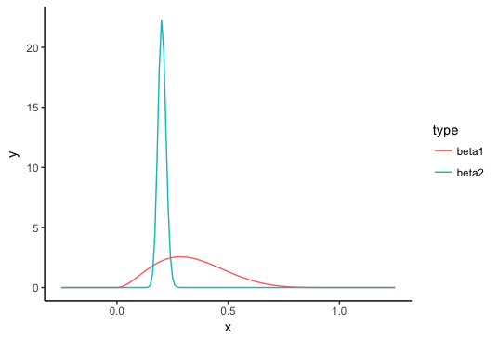
Naïve Bayes
Example
Coin tosses. We toss a coin N times and annotate if it comes up heads (v^{n} = 1) or tails (v^{n} = 0). We observe
Nh=1, Nt=4
Nh=100, Nt=400
Assume prior=Beta(2,2)

Slide 32
Naïve Bayes
Rerences
Bayesian Reasoning and Machine Learning, David Barber
Think Bayes, Dourney
Bayesian Methods for Data Analysis, Carlin & Louis
Machine Learning, a probabilistic perspective, Murphy

Slide 33
Bayesian Statistics. Naïve Bayes
María Hernández Rubio
@maria_hr

